Slide 1
Country Financial - Model Explainability Practicum
Ajay Raigaga
Keren Chen
Rohaan Raheja

Slide 2

Company & Project Introduction
Country Financial: US-based company that provides insurance (auto, home, life) and financial services (retirement, investment) to individuals and families.
Subrogation: the legal right of an insurance company to request reimbursement from the at-fault party after it has paid a covered claim.
Country Financial uses a Multimodal (text + tabular) Deep Learning model to help predict whether they should pursue subrogation on a claim or not.
Project Scope: to build explainability techniques into their deep learning model to help explain how the model came to its prediction. Output results in Streamlit.
Strategic Impact: Improves subrogation decision-making by highlighting key prediction drivers, enabling more data-driven recoveries and enhancing transparency & trust in AI for less technically skilled business leaders.

Slide 3
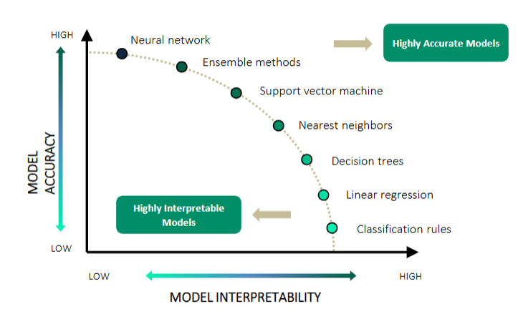
Business Problem & Its Importance
Core Business Problem: While precise, neural networks are inherently difficult to interpret (black box), making it hard for non-technical stakeholders to understand why a claim is flagged for subrogation.
Why It Matters: As the insurance industry relies more and more heavily on AI, CF needs explainable AI to build trust, enable oversight, and support decision-making among business leaders who rely on these models but don’t understand what goes on “under the hood.”

Slide 4
Business Objectives
01
02
03
04
Enable clear, accessible explanations of model outputs for internal stakeholders
Maintain model fidelity while improving transparency
Support faster, more confident subrogation reviews by surfacing key drivers
Improve business adoption and oversight of AI tools through explainability

Slide 5
Accessibility Challenges
Issue: CF was not able to give us access to their internal subrogation model or their training data
Solution: Create our own MMDL model on a mock dataset of Airbnb listings that uses the same text + tabular data architecture as CF’s model.
Same Multimodal Deep Learning Model Architecture, but instead of predicting whether or not to pursue subrogation, our model predicts whether a certain airbnb listing costs >$100 per night or not.
Country Financial will adapt our model to their use case

Slide 6
Technical Problem Statement
We aimed to build an explainable machine learning dashboard to classify Airbnb listings as either “Affordable” (≤ $100) or “Expensive” (> $100). The objective wasn’t just accurate prediction, but also transparency — helping end-users and stakeholders understand why a listing was categorized a certain way.
This required handling both structured inputs (e.g., number of beds, reviews, bathrooms) and unstructured inputs (e.g., listing name and description).
We framed the problem as a binary classification task, with a focus on ensuring the model was both effective and interpretable.
Success criteria included:
High classification accuracy
Clear explanations for each prediction using SHAP, LIME, and PDPs
An intuitive dashboard experience for non-technical users

Slide 7
Data Overview
• Dataset: Public Melbourne Airbnb dataset (mock stand-in for client data)
• Total observations: ~10,000
• Text features: Listing Name, Description
• Tabular features: Beds, Bathrooms, Number of Reviews, Latitude, etc.
• Affordability label: Binary based on price threshold ($100)

Slide 8
Development Stack
• Streamlit: Dashboard interface
• Python (scikit-learn, TensorFlow): Modeling and preprocessing
• SHAP & LIME: Explainable AI techniques
• TF-IDF: Text vectorization
• Combined model: Tabular + Text processed via deep learning layers (128 → 64 → 1)

Slide 9
Model Architecture Overview
• Input Layer: Text (TF-IDF vectorized) + Tabular features
• Hidden Layers: Dense (128, ReLU) → Dense (64, ReLU)
• Output Layer: Sigmoid for binary classification
• Explanation Layer: SHAP & LIME show top contributing tokens & features

Slide 10
Dashboard Outputs & Interpretability
• Classification probability display with confidence score
• Token-level contribution charts (positive vs. negative influence)
• SHAP plots to explain feature influence
• PDP plots to show interaction between input features and predictions

Slide 11

Solution Walkthrough – Explainable AI for Airbnb Pricing
Deep learning model combining tabular and text features
Built using Streamlit
Fully interactive UI with model explainability (SHAP, LIME, PDP)

Slide 12
Challenges & Learnings
No Access to Country Financial’s Internal Subrogation Model or Training Data
This significantly shaped our approach. Since we couldn’t use their real system, we simulated a parallel high-cost classification task using public Airbnb data.
High-Dimensional Input (311 features)
Combining tabular and text features led to shape mismatches in some explainability modules (e.g., SHAP and PDP) → solved by decoupling components and selectively using explainers per feature type.
Model Compatibility for Explainability
PDP could not work directly with the Keras model → resolved with a Random Forest surrogate trained on tabular features only.
Agile Iteration & Prioritization
Requirements evolved mid-project → team reprioritized explainability and reduced scope on some initial ML experiments.
Clear Technical Communication
Translating deep learning behavior into business-relevant insights required visual storytelling, not just code or metrics.

Slide 13
Future Scope & Recommendations
Future Steps:
Replace the Airbnb dataset with CF’s real multimodal subrogation data for higher business relevance.
Optimize model training and explanation generation to reduce runtime in Streamlit.
Integrate an LLM into the explainability techniques to create a textual explanation of what each visual tells us.
Company Recommendations:
Train claims staff and business leaders to interpret know how to interpret explainability results for review and oversight.
Build internal tooling around this app framework to support additional use cases (e.g., fraud detection, underwriting risk).

Slide 14
Appendix
Airbnb dataset: https://www.kaggle.com/datasets/tylerx/melbourne-airbnb-open-data/data
Model Architecture
Sequential neural network with dense and dropout layers
Tuned for binary classification with sigmoid output
Data Preprocessing
Tabular: Missing value imputation, numeric scaling
Text: Combined fields, TF-IDF vectorization (300 features)
Explainability Techniques
SHAP: Feature-level impact
LIME: Token-level impact on text predictions
PDP: Visualizes average feature effect on prediction
Visuals in Streamlit
SHAP force plot, beeswarm plot, SHAP word importance vs frequency bar plot, SHAP observation importance bar plot
LIME bar chart + token saliency map for observation-level word importance
1D and 2D PDPs for tabular interactions

Slide 15
Thank you! + Q&A

